Slide 1
Developing and implementing systems of ODEs
Mathematical modelling and machine learning, 2nd of March 2022
Notes:
14.00-16.00 session

Slide 2
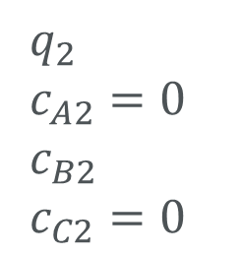
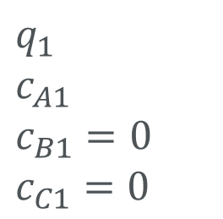
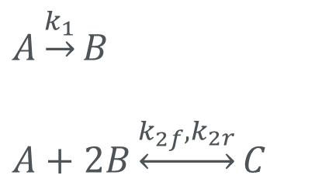
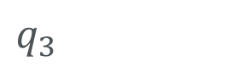
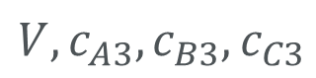
Consider the following system
$q_{1}$
$c_{A1}$
$c_{B1}=0$
$c_{C1}=0$
$q_{2}$
$c_{A2}=0$
$c_{B2}$
$c_{C2}=0$
$A\underset{→}{k_{1}}B$
$A+2B\underset{↔}{k_{2f},k_{2r}}C$
$V, c_{A3},c_{B3},c_{C3}$
$q_{3}$

Slide 3
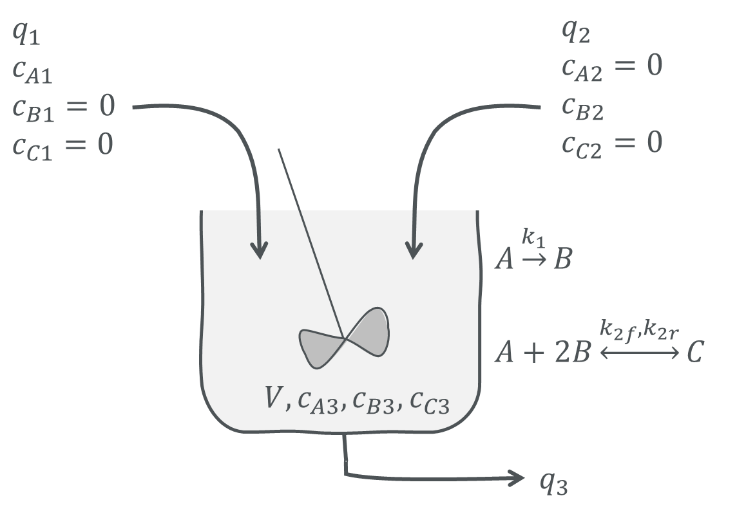
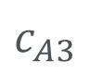
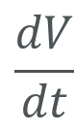
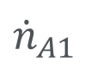
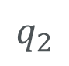
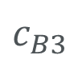
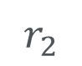
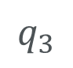
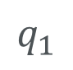
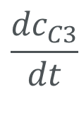
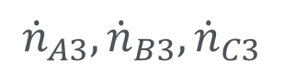
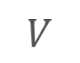
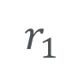
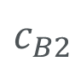
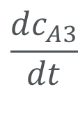
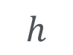
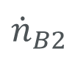
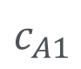
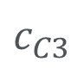
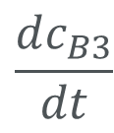
Consider the following system
$$q_{1}$$
$$\frac{dV}{dt}$$
$$c_{A1}$$
$${\dot{n}}_{A1}$$
$$q_{3}$$
$$q_{2}$$
$$h$$
$$\frac{dc_{A3}}{dt}$$
$${\dot{n}}_{A3}, {\dot{n}}_{B3}, {\dot{n}}_{C3}$$
$$c_{B2}$$
$${\dot{n}}_{B2}$$
$$V$$
$$\frac{dc_{B3}}{dt}$$
$$c_{A3}$$
$$c_{B3}$$
$$r_{1}$$
$$\frac{{dc}_{C3}}{dt}$$
$$c_{C3}$$
$$r_{2}$$

Slide 4
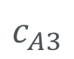
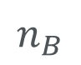


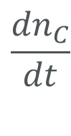
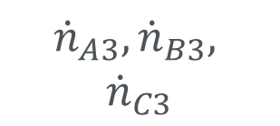

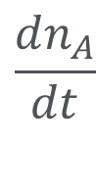
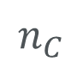
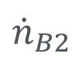
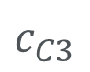
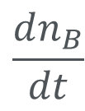
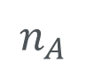
Consider the following system
$$q_{1}$$
$$\frac{dV}{dt}$$
$$c_{A1}$$
$${\dot{n}}_{A1}$$
$$q_{3}$$
$$q_{2}$$
$${\dot{n}}_{B2}$$
$$h$$
$$\frac{dn_{A}}{dt}$$
$$c_{B2}$$
$${\dot{n}}_{A3}, {\dot{n}}_{B3},$$
$${\dot{n}}_{C3}$$
$$V$$
$$\frac{dn_{B}}{dt}$$
$$n_{A}$$
$$c_{A3}$$
$$r_{1}$$
$$n_{B}$$
$$\frac{{dn}_{C}}{dt}$$
$$c_{B3}$$
$$n_{C}$$
$$r_{2}$$
$$c_{C3}$$

Slide 5
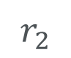
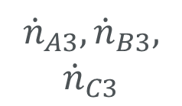
Consider the following system
$$q_{1}$$
$$\frac{dV}{dt}$$
*
$$c_{A1}$$
$${\dot{n}}_{A1}$$
$$q_{3}$$
$$q_{2}$$
$${\dot{n}}_{B2}$$
$$h$$
$$\frac{dn_{A}}{dt}$$
$$c_{B2}$$
*
$${\dot{n}}_{A3}, {\dot{n}}_{B3},$$
$${\dot{n}}_{C3}$$
$$V$$
*
$$\frac{dn_{B}}{dt}$$
$$n_{A}$$
$$c_{A3}$$
$$r_{1}$$
$$n_{B}$$
$$\frac{{dn}_{C}}{dt}$$
$$c_{B3}$$
$$n_{C}$$
$$r_{2}$$
$$c_{C3}$$

Slide 6
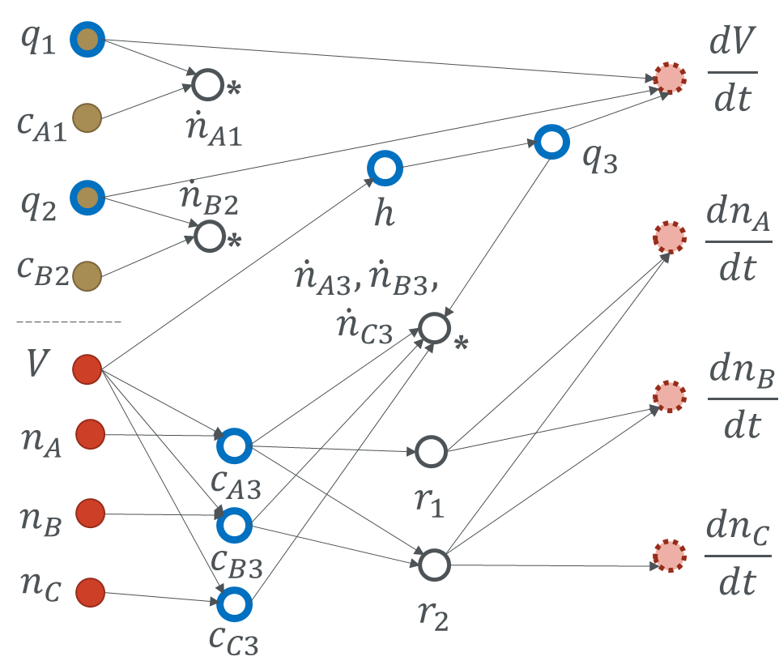
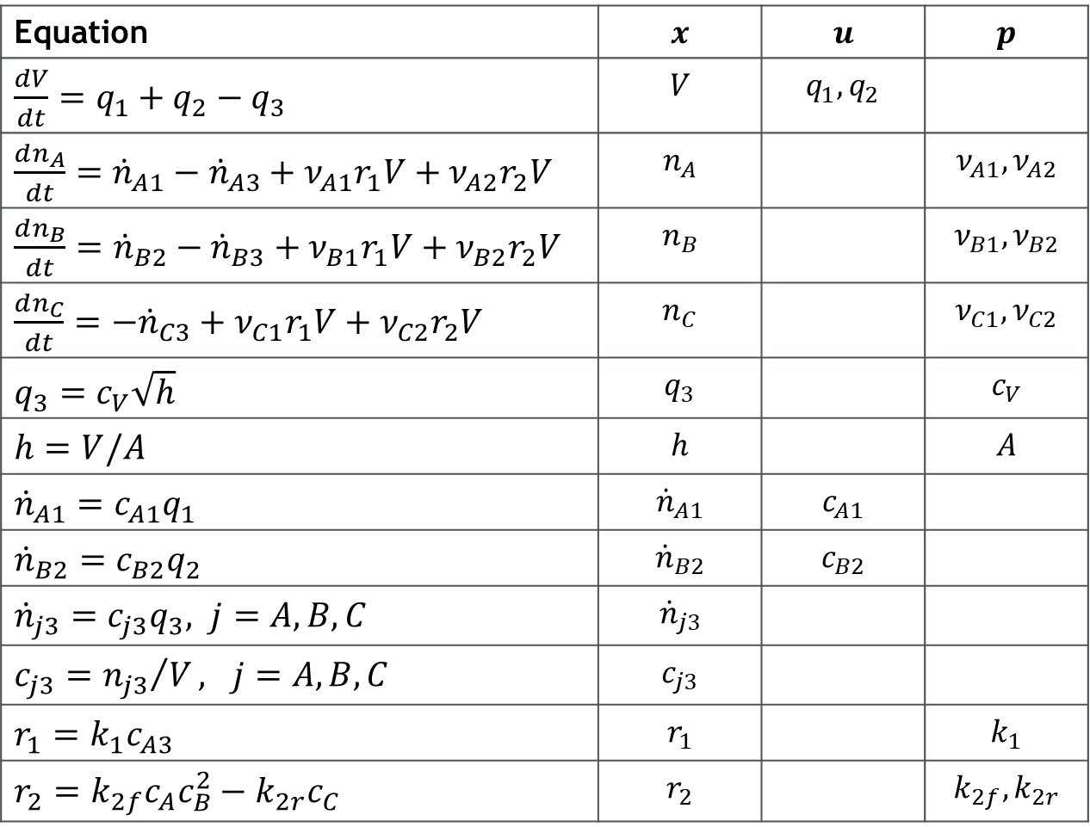
Consider the following system
Equation | $$x$$ | $$u$$ | $$p$$
$\frac{dV}{dt}=q_{1}+q_{2}−q_{3}$ | $$V$$ | $$q_{1}, q_{2}$$
$\frac{dn_{A}}{dt}={\dot{n}}_{A1}−{\dot{n}}_{A3}+ν_{A1}r_{1}V+ν_{A2}r_{2}V$ | $$n_{A}$$ |  | $$ν_{A1},ν_{A2}$$
$\frac{dn_{B}}{dt}={\dot{n}}_{B2}−{\dot{n}}_{B3}+ν_{B1}r_{1}V+ν_{B2}r_{2}V$ | $$n_{B}$$ |  | $$ν_{B1},ν_{B2}$$
$\frac{dn_{C}}{dt}=−{\dot{n}}_{C3}+ν_{C1}r_{1}V+ν_{C2}r_{2}V$ | $$n_{C}$$ |  | $$ν_{C1},ν_{C2}$$
$q_{3}=c_{V}\sqrt{h}$ | $$q_{3}$$ |  | $$c_{V}$$
$h=V/A$ | $$h$$ |  | $$A$$
${\dot{n}}_{A1}=c_{A1}q_{1}$ | $${\dot{n}}_{A1}$$ | $$c_{A1}$$
${\dot{n}}_{B2}=c_{B2}q_{2}$ | $${\dot{n}}_{B2}$$ | $$c_{B2}$$
${\dot{n}}_{j3}=c_{j3}q_{3}, j=A,B,C$ | $${\dot{n}}_{j3}$$
$c_{j3}={n_{j3}}/V, j=A,B,C$ | $$c_{j3}$$
$r_{1}=k_{1}c_{A3}$ | $$r_{1}$$ |  | $$k_{1}$$
$r_{2}=k_{2f}c_{A}c_{B}^{2}−k_{2r}c_{C}$ | $$r_{2}$$ |  | $$k_{2f},k_{2r}$$

Slide 7
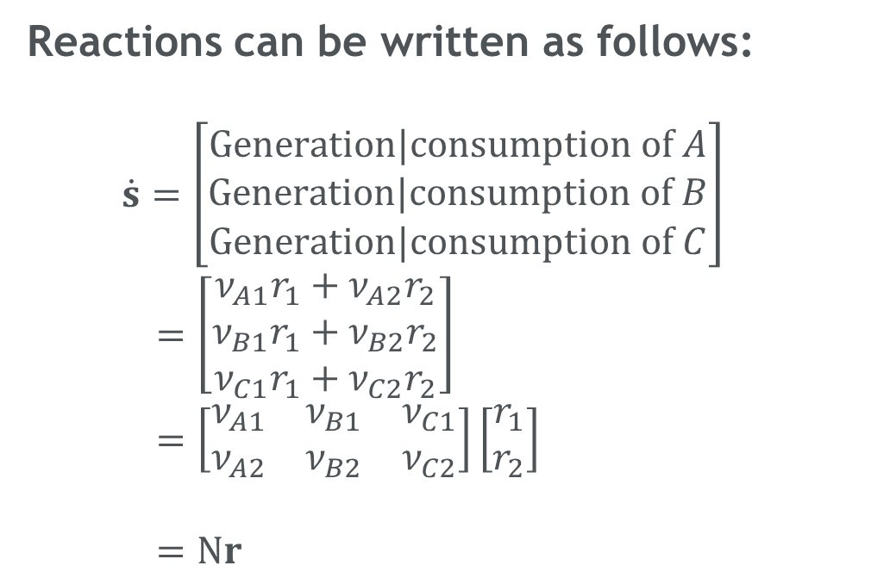
Consider the following system
Reactions can be written as follows:
$\dot{s}=\left[\begin{aligned}Generation|consumption of A \\ Generation|consumption of B \\ Generation|consumption of C\end{aligned}\right]$
$=\left[\begin{aligned}ν_{A1}r_{1}+ν_{A2}r_{2} \\ ν_{B1}r_{1}+ν_{B2}r_{2} \\ ν_{C1}r_{1}+ν_{C2}r_{2}\end{aligned}\right]$
$=\left[\begin{matrix}ν_{A1} & ν_{B1} & ν_{C1} \\ ν_{A2} & ν_{B2} & ν_{C2}\end{matrix}\right]\left[\begin{aligned}r_{1} \\ r_{2}\end{aligned}\right]$
$=Νr$

Slide 8
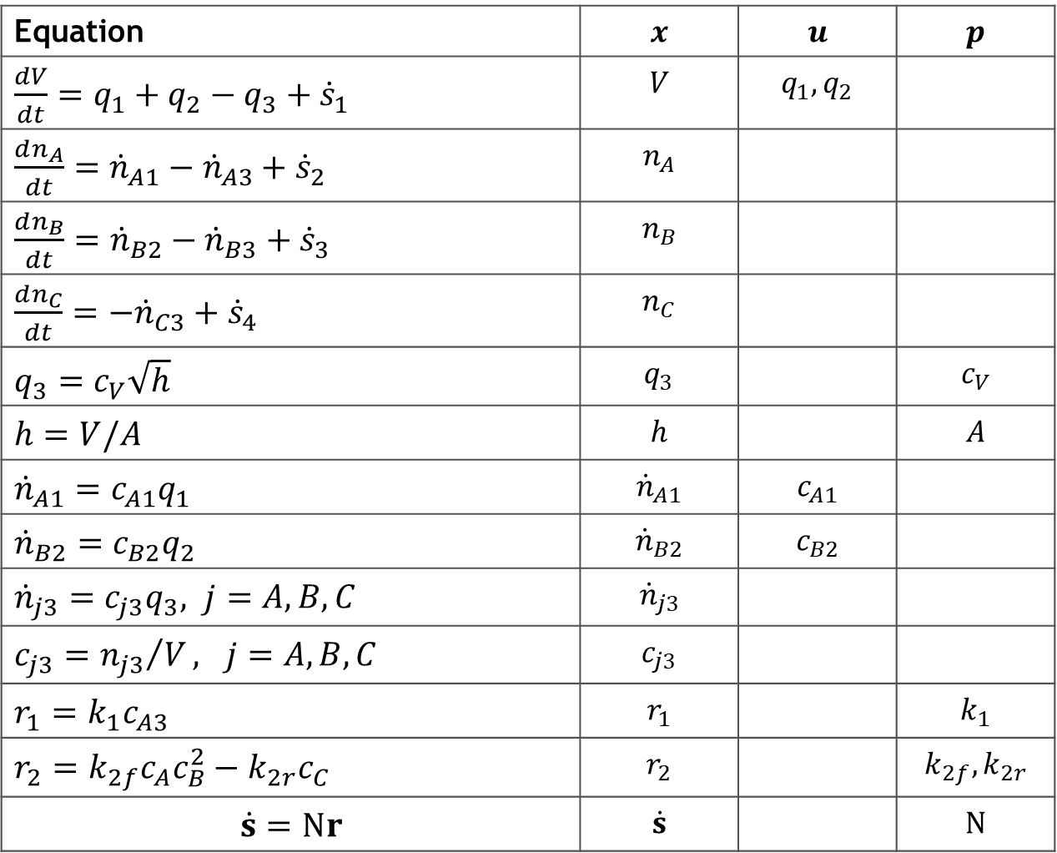
Consider the following system
Equation | $$x$$ | $$u$$ | $$p$$
$\frac{dV}{dt}=q_{1}+q_{2}−q_{3}+{\dot{s}}_{1}$ | $$V$$ | $$q_{1}, q_{2}$$
$\frac{dn_{A}}{dt}={\dot{n}}_{A1}−{\dot{n}}_{A3}+{\dot{s}}_{2}$ | $$n_{A}$$
$\frac{dn_{B}}{dt}={\dot{n}}_{B2}−{\dot{n}}_{B3}+{\dot{s}}_{3}$ | $$n_{B}$$
$\frac{dn_{C}}{dt}=−{\dot{n}}_{C3}+{\dot{s}}_{4}$ | $$n_{C}$$
$q_{3}=c_{V}\sqrt{h}$ | $$q_{3}$$ |  | $$c_{V}$$
$h=V/A$ | $$h$$ |  | $$A$$
${\dot{n}}_{A1}=c_{A1}q_{1}$ | $${\dot{n}}_{A1}$$ | $$c_{A1}$$
${\dot{n}}_{B2}=c_{B2}q_{2}$ | $${\dot{n}}_{B2}$$ | $$c_{B2}$$
${\dot{n}}_{j3}=c_{j3}q_{3}, j=A,B,C$ | $${\dot{n}}_{j3}$$
$c_{j3}={n_{j3}}/V, j=A,B,C$ | $$c_{j3}$$
$r_{1}=k_{1}c_{A3}$ | $$r_{1}$$ |  | $$k_{1}$$
$r_{2}=k_{2f}c_{A}c_{B}^{2}−k_{2r}c_{C}$ | $$r_{2}$$ |  | $$k_{2f},k_{2r}$$
$$\dot{s}=Νr$$ | $$\dot{s}$$ |  | $$Ν$$

